Slide 1
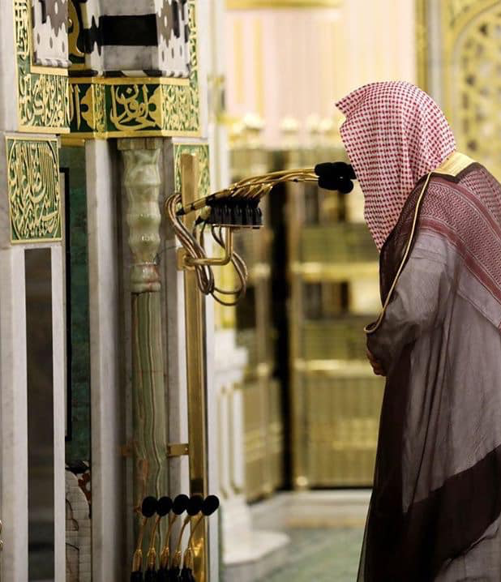
A Hafiz’s Guide to Tarawih Recitation
بسم الله الرحمن الرحيم
Muhammad Ziyad Batha

Slide 2

Why we Recite the Qur’an in Tarawih
Ramadan is the Month of Qur’an.
Prophet g recited to Jibril n every Ramadan. Twice in final year.
Continuous practice of Ummah during Tarawih – to connect people to the Qur’an during Ramadan.
Not a soulless ritual or parrot-fashion. Our recitation should be a means of connecting people to Allah by facilitating reflection and contemplation (tadabbur).
What about those who don’t understand Arabic? When recited “haqqa tilawatih” it still has a powerful effect. Intrinsically has the power to touch hearts and transform.
Try to summarise the recited portion to the congregation in English (Either after fard, 8 rakaʿahs, end, before maghrib)
CONNECTION

Slide 3
The 2 Levels of Recitation (Tilawah)
Correct Tilawah
Elite Tilawah
The Prophet g said: “Allah loves the Qur’an to be recited as it was revealed.”
Anas ibn Malik & Umm Salamah described the Prophet’s g recitation as clear, letter by letter, stretched.

Slide 4
What is Correct Tilawah?
To recite in the way the Prophet did with Tartil
ورتل القرآن ترتيلا
Enunciate clearly (Ibn ʿAbbas)
Pronounce clearly and distinguish all letters from each other - (Dahhak)
Correctly pronounce letters and knowing where to pause - (ʿAli)

Slide 5
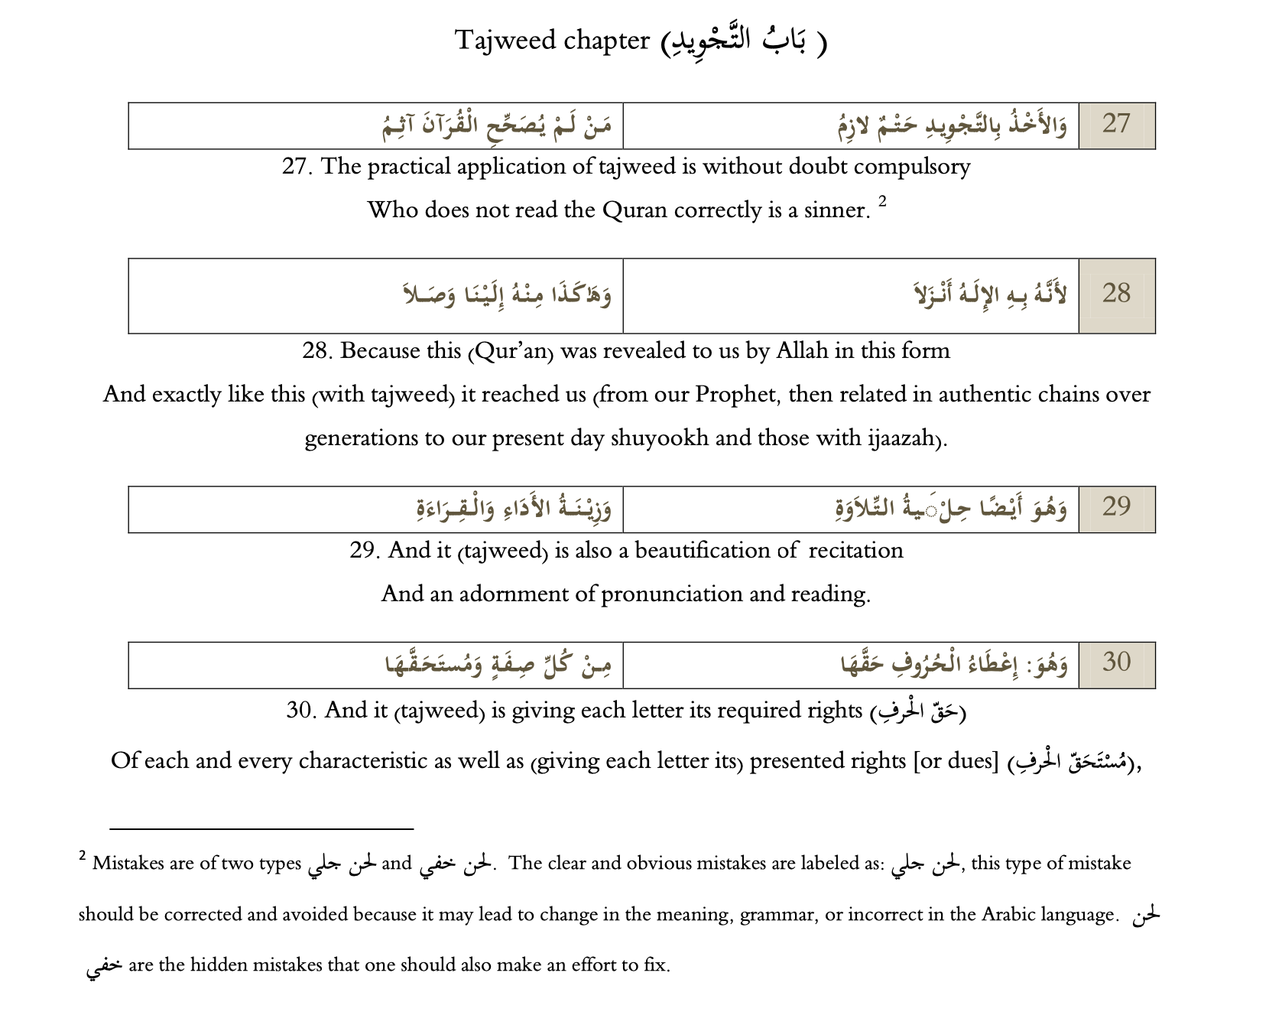
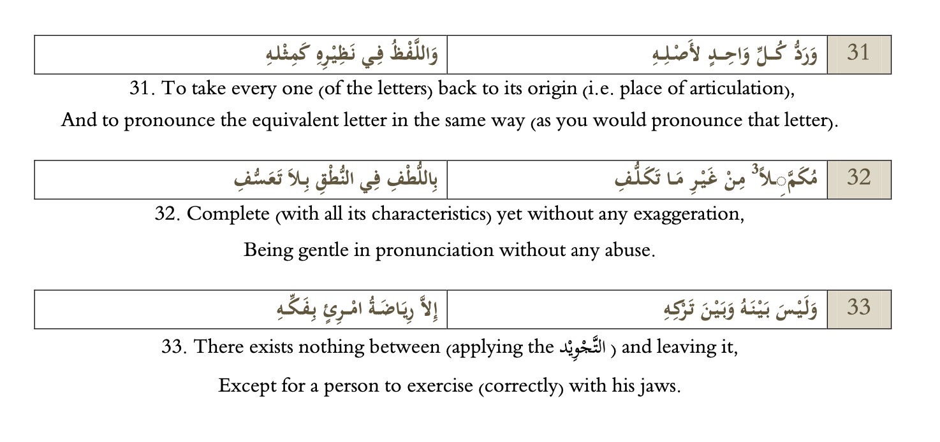
Ibn al-Jazari’s Guide to Correct Tilawah
Avoiding Lahn Jali (Major Errors)
Try to avoid Lahn Khafi (Lesser Errors)
Every letter clear and distinguished, exiting from its correct makhraj with unique qualities
Applying Temporary Qualities/Muhassanat
Completing Harakat – don’t eat them up!
Consistency in pronounciation and durations
Avoid takalluf (exaggeration)
Hadr Pace
Applying rules of the riwayah (Hafs via Shatibiyyah or Misbah etc)

Slide 6
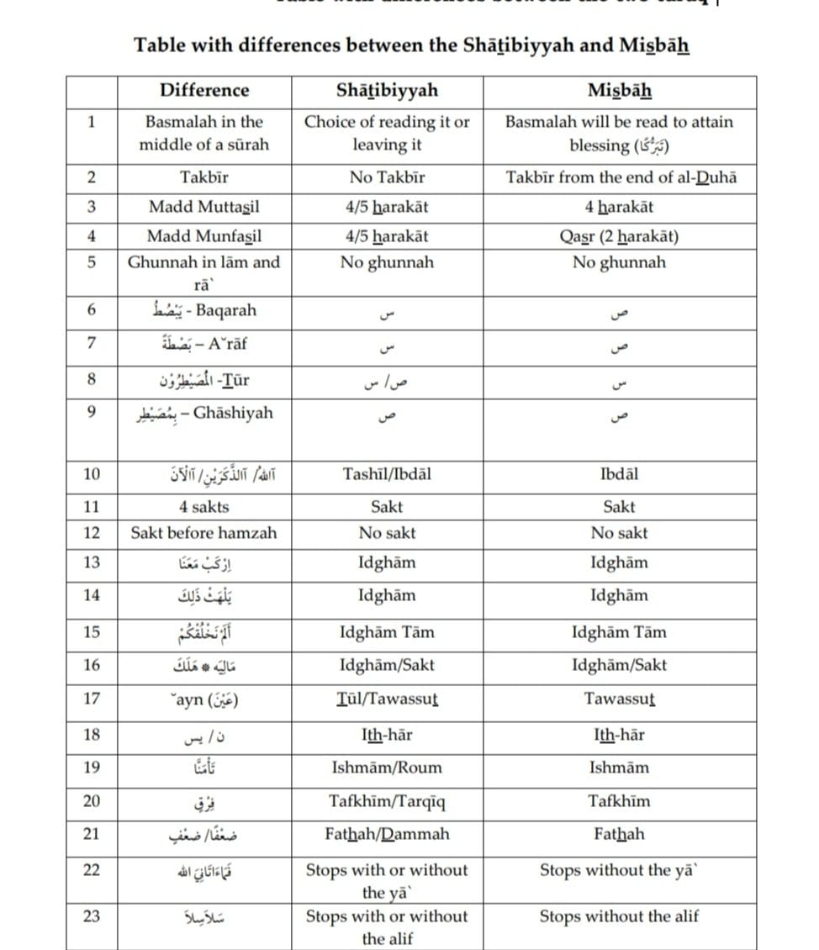
Short Munfasil vs
Long Munfasil
Mixing between paths (turuq) is generally discouraged
مجرها
أأعجمي

Slide 7
What is Elite Tilawah?
Tone
tailored to suit the meanings
01
Nabr
(lexical/prosodic stress) to accentuate meanings
02
Waqf and Ibtida’ (stopping and starting) that makes sense according to meanings
03

Slide 8
The Elite Tilawah - Tone
Jabir reported that the Messenger of Allah g said:
“Verily, among the people who recite the Quran with the best voice are those who, when you hear them, you consider them in awe of Allah.”
ʿAbdullah ibn Masʿud said:
Do not recite the Qur’an the way poetry is recited and do not scatter it like poor quality dates [falling from a tree]. Rather, pause at its wonders and move the hearts by it. Let not your concern be reaching the end of the surah.
Nawawi reports that ʿUmar raised his voice when reaching the verses:
فَلْيَعْبُدُوا رَبَّ هَٰذَا الْبَيْتِ - وَهَٰذَا الْبَلَدِ الْأَمِينِ
Nakhaʿi said: It is of utmost importance for the reciter to lower his voice when he recites:
وَقَالَتِ الْيَهُودُ عُزَيْرٌ ابْنُ اللَّهِ وَقَالَتِ النَّصَارَى الْمَسِيحُ ابْنُ اللَّه

Slide 9
The Elite Tilawah - Nabr
ʿAbdullah ibn Masʿud said:
“Beautify [by applying Tajwid to the recitation of] the Qur’an, adorn its recitation with the best of voices and Arabicize it, for indeed the Qur’an is in the Arabic language; and Allah loves that it [the Qur’an] be Arabicized.”
Imperatives, negations, separating prepositions from verbs/nouns, etc.
“I Will Tell You”
وذروا – فنظرة – هو/هم – ما كان/ما بناها –
يعظُكم (لإتمام الحركة)

Slide 10
Waqf and Ibtida’ (Pausing and Continuing)
Take Care In…
Setting Daily Portions (Juz’ doesn’t always end the topic!)
Intra-Verse Pauses
Waqf Signs
Be aware of what the signs mean (Sajawandi symbols)
The basis: following the meaning – can be more than one option (e.g. Min Walad… Subhanah!)
Starting and Ending Rakaʿat
Indo-Pak and Madinah Mushaf systems
Notes:
Stopping at Ayah ends Sunnah or not? Some say yes (even if grammar not complete) others say its on meaning.
ٰE.g., Subh

Slide 11
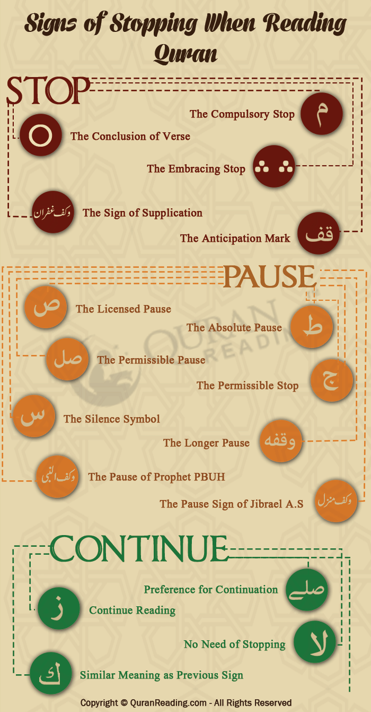
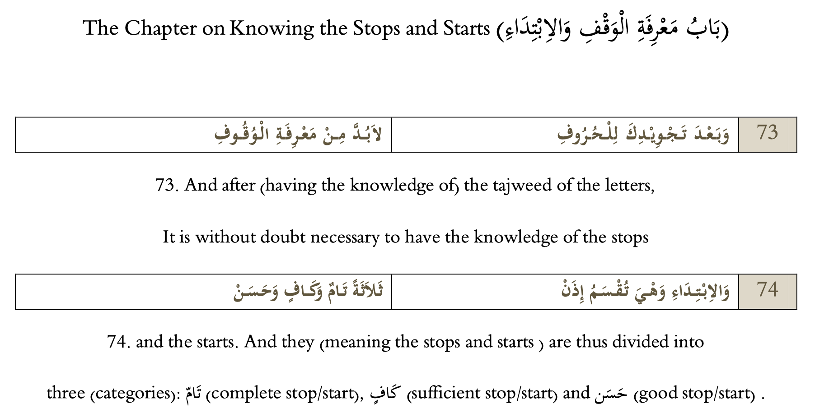
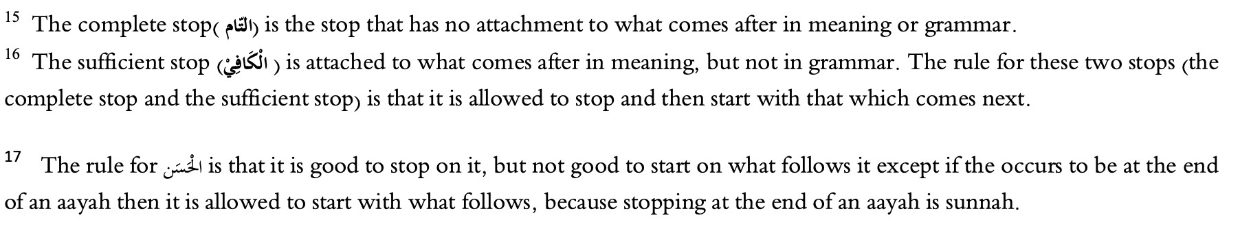
Waqf Qabih (Repulsive): Starting with a word that leads to a meaning in opposition to what Allah intended
Example: Starting with اتَّخَذَ اللَّهُ وَلَدًا and missing the قالوا

Slide 12
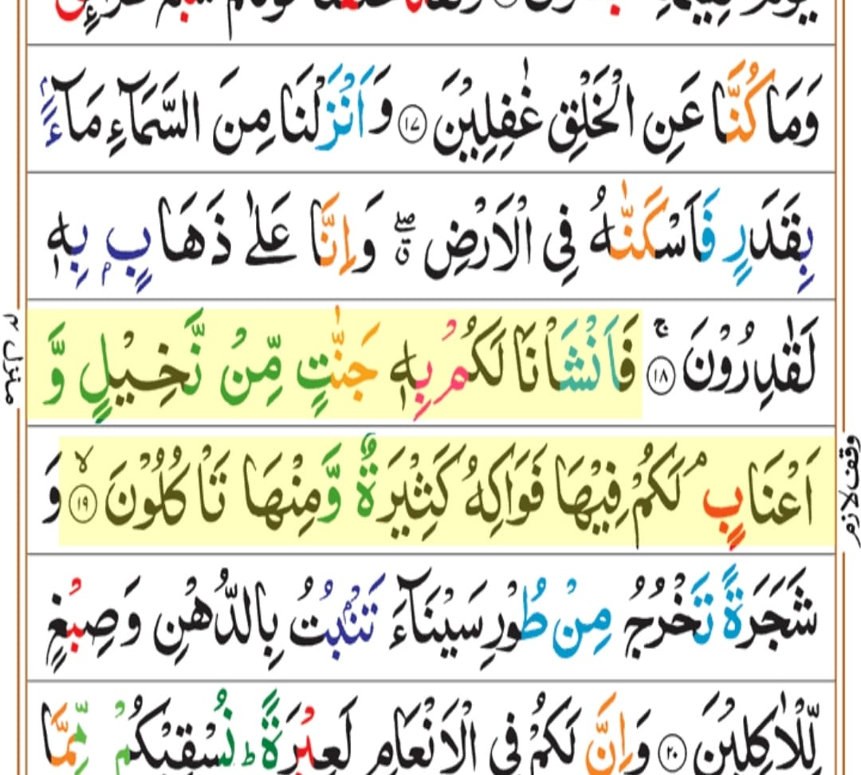
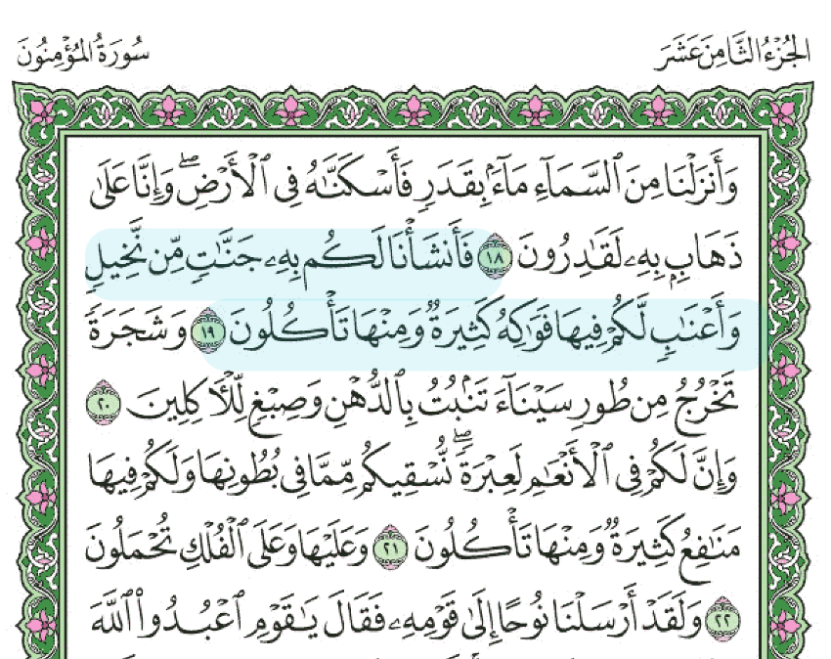
Imam Ibn al-Jazari said:
وليس فى القرآن من وقف وجب
ولا حرام غير ما له سبب
Spot the Difference!

Slide 13
Other Tips
  Practice at the pace at which you intend to recite in Tarawih. Hadr.
  Plan your raka’ah start/stops and your intra-rak’ah stops by looking at the waqf signs and meanings
  Read a translation
  Listen to good reciters and focus on tone and starting/stopping. From current Imams, Shaykh Juhany (Makkah) is excellent with stopping and starting. Shaykh Ahmad Talib Hameed (Madinah) is also very good.
  If you get stuck, don’t make noises or say ‘hmm’ or ‘no’. Just start the ayah or previous ayah again.
Notes:
If the sound that one made resembles sounds one makes when speaking, then it would invalidate the prayer if it is equivalent to two letters such as ‘b-b’, two sounds that sound like the letter ‘b’. If it was only one such sound then it will not invalidate the prayer. If the sound was some sort of guttural sound or from the chest then it will not invalidate as one does not articulate letters from such places (Radd al-Muhtar)

Slide 14
  Remember that you are representing the people behind you before Allah. Make sure you fulfill this responsibility by rectifying intentions and ensuring you embody the character of a person of Qur’an:
    أُولُو الْبِرِّ وَالإِحْسَانِ وَالصَّبْرِ وَالتُّقَى ... حُلاَهُمُ بِهَا جَاءَ الْقُرَانُ مُفَصَّلَا؛ عَلَيْكَ بِهَا مَا عِشْتَ فِيهَا مُنَافِساً... وَبِعْ نَفْسَكَ الدُّنْيَا بِأَنْفَاسِهَا الْعُلَا
Al-Ḥasan al-Baṣrī (rh) said:
  “Certainly, slaves and children recite the Qur’an and they have no knowledge of its meaning. They memorised its letters but neglected its commands, to the extent that one of them will say, “By Allah, I have recited the entire Qur’an without missing out on any letter.” By Allah, he has missed out on all of it! For there is no effect of the Qur’an on his character and actions. By Allah, it is not about memorising its letters, and then neglecting its commands!”

Slide 15
اللهم اجعلنا ممن يقرأ القرآن فيرقى
ولا تجعلنا ممن يقرأ القرآن فيذل ويشقى
O Allah!
Make us among those who [correctly] recite the Qur’an and then ascend!
And do not make us among those who recite the Qur’an [not meeting its conditions] and are thus disgraced and wretched!

